Slide 1
Backup & Archiving Market Insights
Futurewei Intelligent Data Lab
3/7/2022

Slide 2
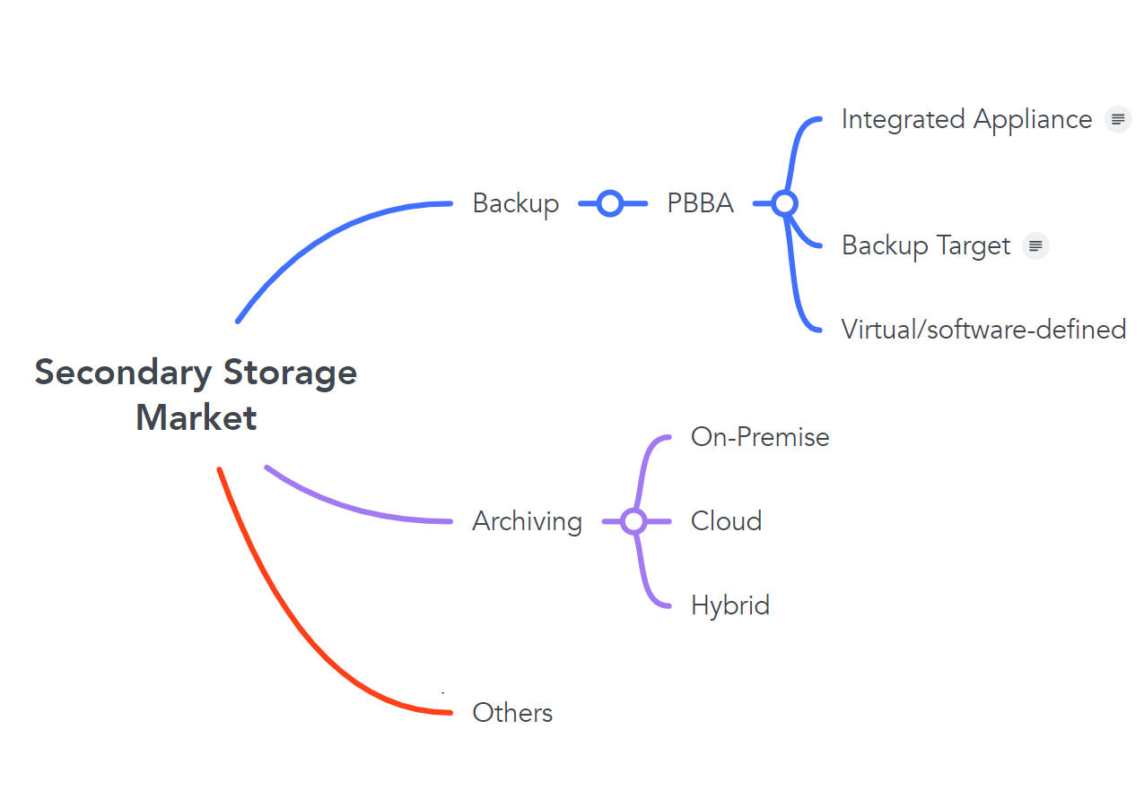
Secondary Storage Market
Key Drivers:
Data Boom:
175 Zettabytes by 2025, 49% in public cloud, about the same in data centers.
Enterprise data to 93 Zettabytes by 2025, 80% capacity in secondary storage
Information governance: regulations and privacy
Enterprises’ digitalization process
Technological advancements
Backup & Recovery Market:
10.05B -> 19.96B (2021 – 2027), CAGR 9.0%
Cloud backup 1.8 B in 2019, CAGR ~20%
PBBA market 4.33B in 2020, 1/3 of the backup market
Enterprise Information Archiving (EIA) market:
5.93B -> 12.49B (2020 – 2026), CAGR 13.51%
Cloud deployment grow at CAGR 15.54%
Major enterprise vendors provide hybrid deployment to multiple targets
2 Trends:
Hybrid Cloud support
Comprehensive Appliances/ Hyper-Converged Data Platform
Notes:
1 Zettabyte = 1000 Exabytes = 1000 petabytes = 1000 terabytes = 1000 gigabyte = 1000 megabyte

Slide 3
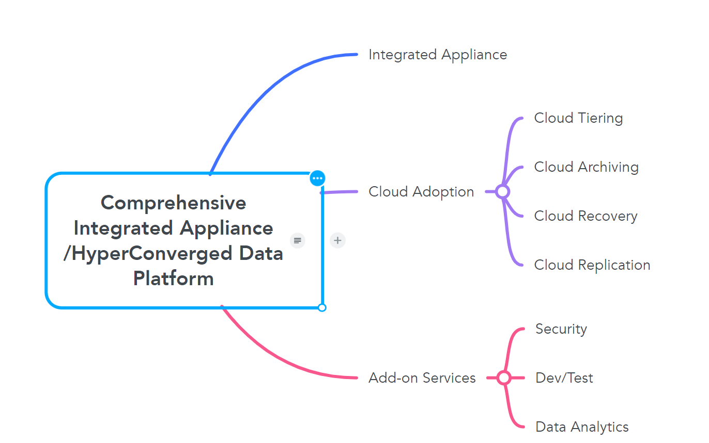
Hyper-Converged Data Platforms
Key Drivers:
Data Fragmentation
Complex data infrastructure and management
Inefficiency: 10-15 redundant copies
Cloud Adoption:
93% organizations adopt hybrid cloud solution
89% will keep on-premise footprint
Privacy and Security issues
Major storage vendors: cloud tiering, archiving, replication, recovery
Add-on Services:
Data Protection: Ransomware protection, antivirus scan data anonymization
Dev/test environments
Data intelligence: data classification, data analytics
Data management
Examples: Cohesity, Rubrik

Slide 4
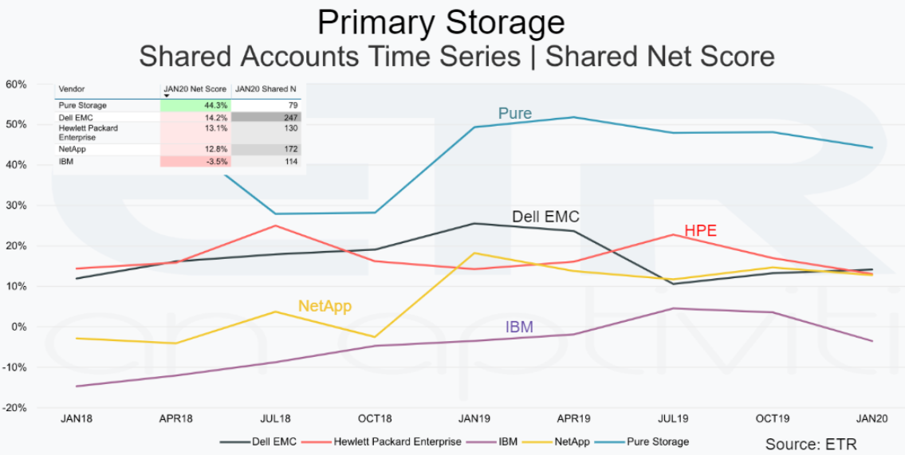
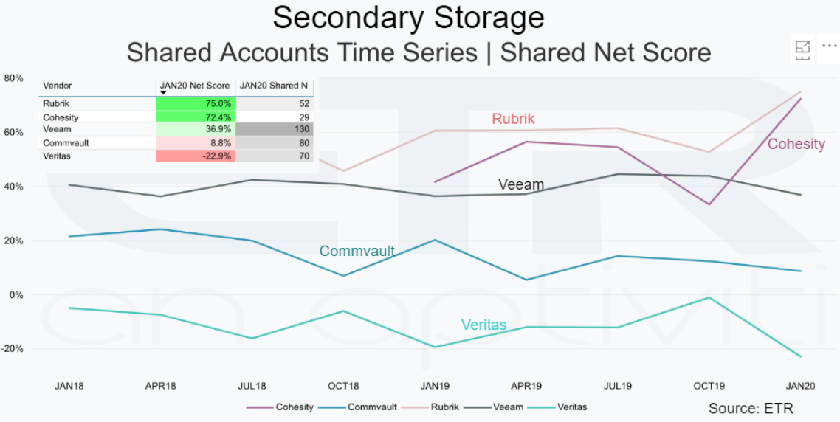
Cohesity
Annual revenue $300 million (7/31/2020 – 7/31/2021), over 70% increase YoY
A 40% increase in the number of customers, with rapid adoption in the Americas, EMEA, and Asia Pacific regions. Cohesity’s customer count is now approximately 2,600.
As of the end of Q4, nearly 25% of the Fortune 500 do business with Cohesity, an increase of more than 35% YoY. Cohesity customers include four of the Fortune top 10 as well as three of the top ten U.S. banks and three of the top five U.S. health insurers.
Notes:
ETR “net score” (spending velocity, whether a customer is planning to spend more on a particular vendor)
Cohesity Fiscal 2021 Results Shatter Previous Performance Records As Customers Embrace Next-Gen Data Management With Built-in Ransomware Data Protection | Cohesity
Cohesity vs Rubrik | Top 6 Essential Differences of Cohesity vs Rubrik (educba.com)

Slide 5
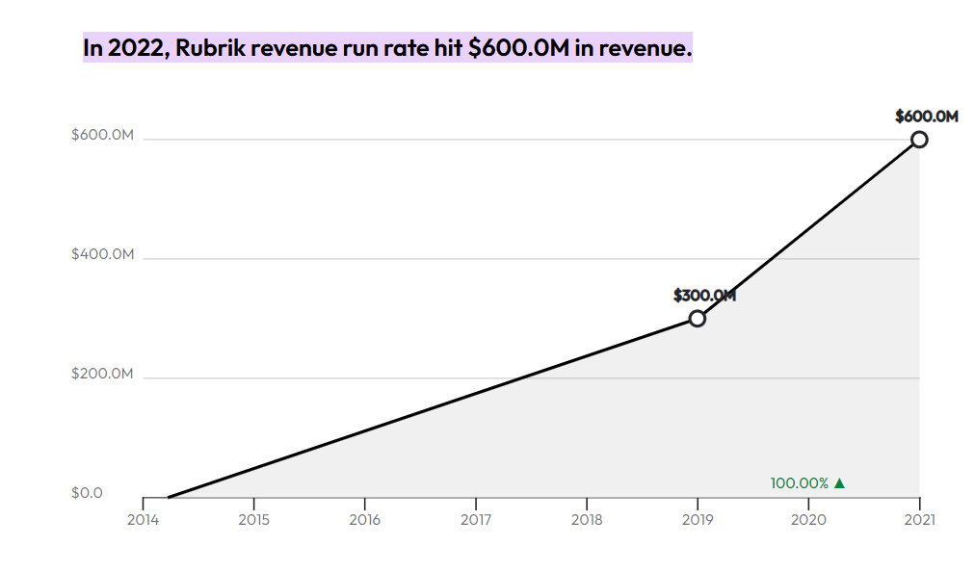
Rubrik
Rubrik revenue run rate hit $600.0M in revenue.
More than 3,200 global customers have chosen Rubrik

Slide 6
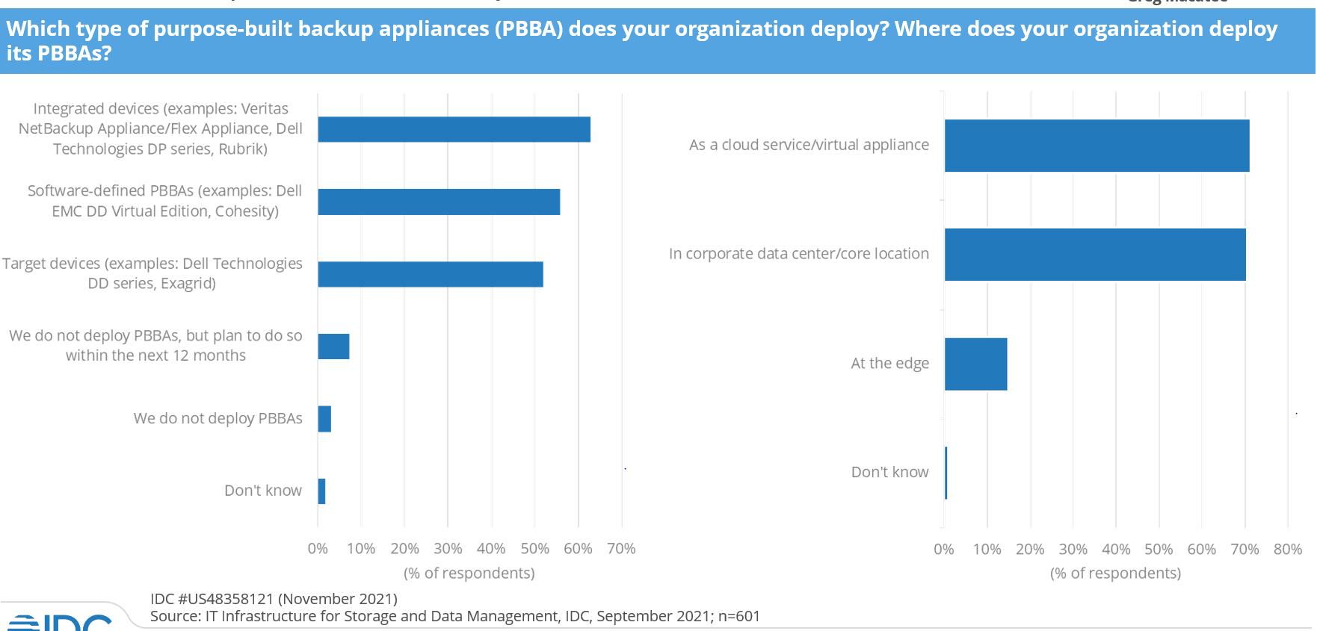
IDC PBBA 3Q/21 Trends

